Slide 1
INTERNET PROGRAMMING II
PHP PART-2

Slide 2
PHP Form Handling
The PHP superglobals $_GET and $_POST are used to collect form-data.
The example below displays a simple HTML form with two input fields and a submit button:
Example
<html>
<body>
<form action="welcome.php" method="POST">
Name: <input type="text" name="name"><br>
E-mail: <input type="text" name="email"><br>
<input type="submit">
</form>
</body>
</html>
When the user fills out the form above and clicks the submit button, the form data is sent for processing to a PHP file named "welcome.php". The form data is sent with the HTTP POST method.

Slide 3
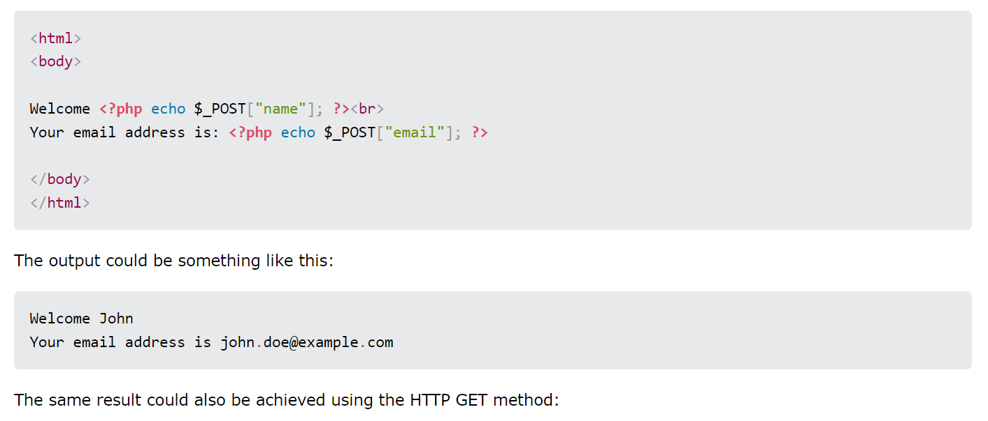
To display the submitted data you could simply echo all the variables.
The "welcome.php" looks like this:

Slide 4
When to use GET?
Information sent from a form with the GET method is visible to everyone (all variable names and values are displayed in the URL).
GET also has limits on the amount of information to send. The limitation is about 2000 characters. However, because the variables are displayed in the URL, it is possible to bookmark the page.
GET may be used for sending non-sensitive data.
Note: GET should NEVER be used for sending passwords or other sensitive information!

Slide 5
When to Use POST?
Information sent from a form with the POST method is invisible to others (all names/values are embedded within the body of the HTTP request) and has no limits on the amount of information to send.
Moreover POST supports advanced functionality such as support for multi-part binary input while uploading files to server.
However, because the variables are not displayed in the URL, it is not possible to bookmark the page.

Slide 6
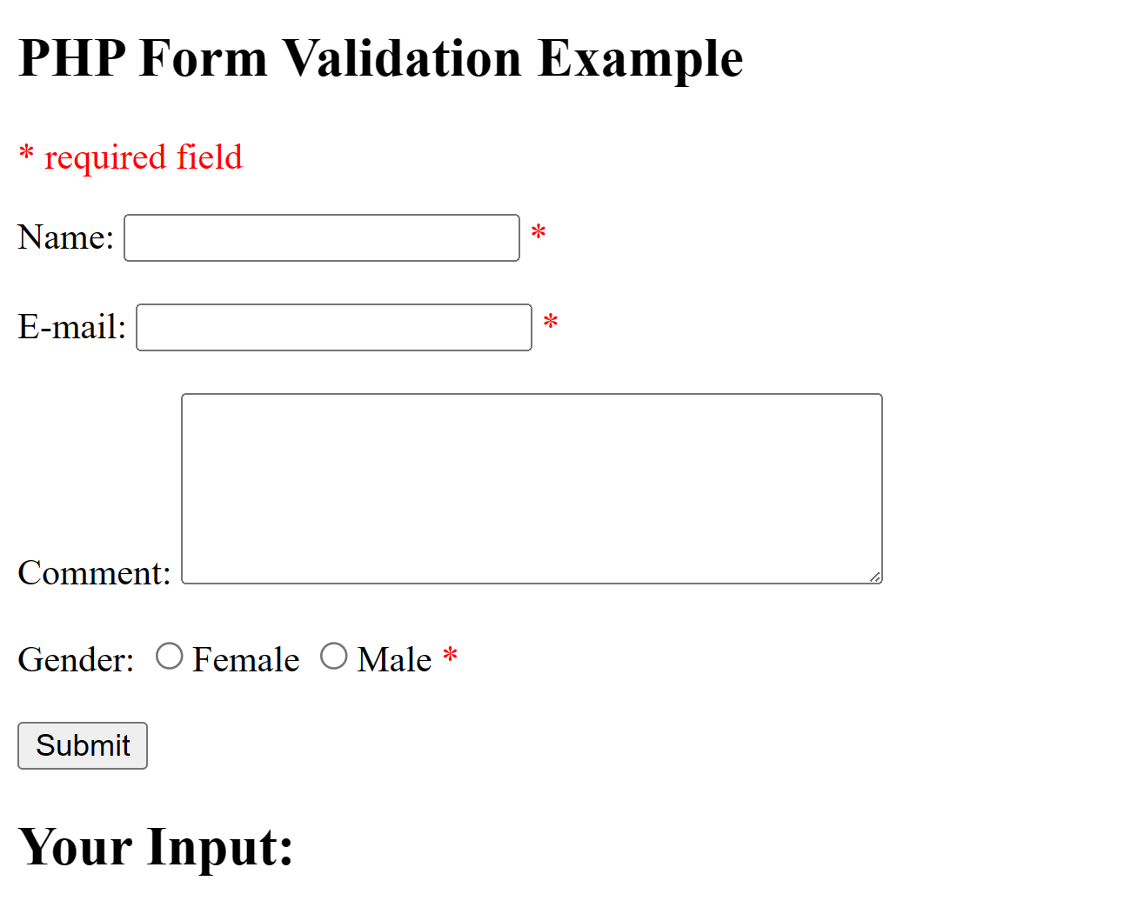
PHP Form Validation
Proper validation of form data is important to protect your form from hackers and spammers!

Slide 7
PHP Form Validation
The validation rules for the form above are as follows: First we will look at the plain HTML code for the form:
Field | Validation Rules
Name | Required. + Must only contain letters and whitespace
E-mail | Required. + Must contain a valid email address (with @ and .)
Comment | Optional. Multi-line input field (textarea)
Gender | Required. Must select one

Slide 8
<h2>PHP Form Validation Example</h2>
<p><span class="error">* required field</span></p>
<form method="post" action="<?php echo htmlspecialchars($_SERVER["PHP_SELF"]);?>">
Name: <input type="text" name="name">
<span class="error">* <?php echo $nameErr;?></span>
<br><br>
E-mail: <input type="text" name="email">
<span class="error">* <?php echo $emailErr;?></span>
<br><br>
Comment: <textarea name="comment" rows="5"
cols="40"></textarea>
<br><br>
Gender:
<input type="radio" name="gender" value="female">Female
<input type="radio" name="gender" value="male">Male
<span class="error">* <?php echo $genderErr;?></span>
<br><br>
<input type="submit" name="submit" value="Submit">
</form>

Slide 9
PHP Form Validation
The $_SERVER["PHP_SELF"] is a super global variable that returns the filename of the currently executing script.
The htmlspecialchars() function converts special characters into HTML entities. This means that it will replace HTML characters like < and > with &lt; and &gt;.
Basically to validate form we can perform the following on each input.
trim - remove unnecessary characters (extra space, tab, newline)
stripslashes - Remove backslashes (\)
htmlspecialchars - converts special characters to HTML entities

Slide 10
<?php
// define variables and set to empty values
$nameErr = $emailErr = $genderErr = "";
$name = $email = $gender = $comment = "";
if ($_SERVER["REQUEST_METHOD"] == "POST") {
if (empty($_POST["name"])) {
$nameErr = "Name is required";
} else {
$name = test_input($_POST["name"]);
if (!preg_match("/^[a-zA-Z-' ]*$/",$name)) {
$nameErr = "Only letters and white space allowed";
}
}
if (empty($_POST["email"])) {
$emailErr = "Email is required";
} else {
$email = test_input($_POST["email"]);
if (!filter_var($email, FILTER_VALIDATE_EMAIL)) {
$emailErr = "Invalid email format";
}
}

Slide 11
if (empty($_POST["comment"])) {
$comment = "";
} else {
$comment = test_input($_POST["comment"]);
}
if (empty($_POST["gender"])) {
$genderErr = "Gender is required";
} else {
$gender = test_input($_POST["gender"]);
}
}
function test_input($data) {
$data = trim($data);
$data = stripslashes($data);
$data = htmlspecialchars($data);
return $data;
}
?>

Slide 12
<?php
echo "<h2>Your Input:</h2>";
echo $name;
echo "<br>";
echo $email;
echo "<br>";
echo $comment;
echo "<br>";
echo $gender;
?>

Slide 13


The PHP Date() Function
The PHP date() function formats a timestamp to a more readable date and time.
A timestamp is a sequence of characters, denoting the date and/or time at which a certain event occurred.
Syntax
date(format,timestamp)
12/10/2019
3

Slide 14
Cont. …
PHP Date() - Format the Date
The required format parameter in the date() function specifies how to format the date/time.
Here are some characters that can be used:
d - Represents the day of the month (01 to 31)
m - Represents a month (01 to 12)
Y - Represents a year (in four digits)
l (lowercase 'L') - Represents the day of the week
<?php echo "Today is " . date("Y/m/d") . "<br>"; echo "Today is " . date("Y.m.d") . "<br>"; echo "Today is " . date("Y-m-d") . "<br>"; echo "Today is " . date("l"); ?>
Example:
output
Today is 2020/11/03 Today is 2020.11.03 Today is 2020-11-03 Today is Tuesday
12/10/2019
4

Slide 15

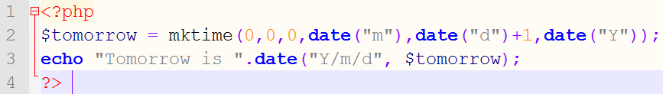
Cont.…
PHP Date() - Adding a Timestamp
The optional timestamp parameter in the date() function specifies a timestamp.
If you do not specify a timestamp, the current date and time will be used.
The mktime() function returns the Unix timestamp for a date.
The Unix timestamp contains the number of seconds between the Unix
Epoch (January 1 1970 00:00:00 GMT) and the time specified.
Syntax for mktime()
mktime(hour,minute,second,month,day,year,is_dst)
To go one day in the future we simply add one to the day argument of mktime():
Example:
5
Notes:
So, the output of this code snippet would be: “Tomorrow is 2024/04/10”.

Slide 16
PHP Include File
Server Side Includes (SSI)
It is used to insert the content of one PHP file into another PHP file before the server executes, with the include() or require() function.
Both are identical in every way, except how they handle errors:
include() generates a warning, but the script will continue execution
require() generates a fatal error, and the script will stop
Both functions are used to create functions, headers, footers, or elements that will be reused on multiple pages.
Server side includes saves a lot of work.
This means that you can create a standard header, footer, or menu file for all your web pages.
When the header needs to be updated, you can only update the include file, or when you add a new page to your site, you can simply change the menu file (instead of updating the links on all your web pages).

Slide 17

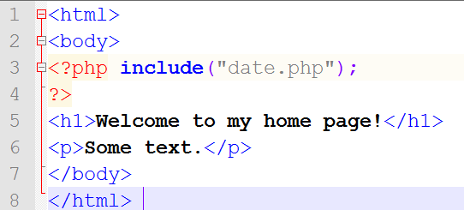

PHP include() Function
The include() function takes all the content in a specified
file and includes it in the current file.
If an error occurs, the include() function generates a warning, but the script will continue execution.
Example
Assume that you have a standard header file, called “date.php". To include the header file in a page, use the
include() function:
output
12/10/2019
7

Slide 18
PHP File Handling
Opening a File
The fopen(parameter1, parameter2) function is used to open files in PHP.
The first parameter of this function contains the name of the file to be opened and the second parameter specifies in which mode the file should be opened:

Slide 19
Modes | Description
r | Read only. Starts at the beginning of the file
r+ | Read/Write. Starts at the beginning of the file
w | Write only. Opens and clears the contents of file; or creates a new file if it doesn't exist
w+ | Read/Write. Opens and clears the contents of file; or creates a new file if it doesn't exist
a | Append. Opens and writes to the end of the file or creates a new file if it doesn't exist
a+ | Read/Append. Preserves file content by writing to the end of the file
x | Write only. Creates a new file. Returns FALSE and an error if file already exists
x+ | Read/Write. Creates a new file. Returns FALSE and an error if file already exists

Slide 20
PHP Create File - fopen()
The fopen() function is also used to create a file
If you use fopen() on a file that does not exist, it will create it, given that the file is opened for writing (w) or appending (a).
The example below creates a new file called "testfile.txt".
The file will be created in the same directory where the PHP code resides:
Example
$myfile = fopen("testfile.txt", "w")

Slide 21
PHP Write to File - fwrite()
The fwrite() function is used to write to a file.
The first parameter of fwrite() contains the name of the file to write to and the second parameter is the string to be written.
The example below writes a couple of names into a new file called "newfile.txt":
Example
<?php
$myfile = fopen("newfile.txt", "w") or die("Unable to open file!");
$txt = "John Alice\n"; fwrite($myfile, $txt);
$txt = “Kelvin Smith\n"; fwrite($myfile, $txt); fclose($myfile);
?>

Slide 22
Cont…
Notice that we wrote to the file "newfile.txt" twice.
Each time we wrote to the file we sent the string $txt that first contained " John Alice " and second contained “Kelvin Smith".
▪
After we
finished writing, we closed the file using
the fclose() function.
If we open the "newfile.txt" file it would look like this:
John Alice Kelvin Smih

Slide 23
PHP Overwriting
Now that "newfile.txt"
contains some data we can show
what happens when we open an existing file for writing.
All the existing data will be an empty file.
ERASED and we start with
In the example below we open our existing file "newfile.txt", and write some new data into it:
Example
<?php
$myfile = fopen("newfile.txt", "w") or die("Unable to open file!");
$txt = "Mickey Mouse\n";
fwrite($myfile, $txt);
$txt = "Minnie Mouse\n"; fwrite($myfile, $txt); fclose($myfile);
?>

Slide 24
PHP File Open/Read/Close
PHP Open File - fopen()
A better method to open files is with the fopen() function.
This function gives you more options than the readfile() function.
The first parameter of
fopen()
contains
the name
of the specifies in
file to be opened and the second
parameter
which mode the file should be opened.
The following example also generates a message if the fopen() function is unable to open the specified file:
Example
<?php
$myfile = fopen(" newfile.txt ", "r") or die("Unable to open file!");
echo fread($myfile,filesize(" newfile.txt "));
fclose($myfile);
?>

Slide 25
PHP Read File - fread()
The fread() function reads from an open file.
The first parameter of fread() contains the name of the file to read from and the second parameter specifies the maximum number of bytes to read.
The following PHP code reads the "webdictionary.txt" file to the end:
fread($myfile,filesize("webdictionary.txt"));

Slide 26
PHP File Upload
With PHP, it is possible to upload files to the server.
Create an Upload-File Form
To allow users to upload files from a form can be very useful.
Example
<!DOCTYPE html> <html> <body> <form action="upload.php" method="post" enctype="multipart/form-data"> Select image to upload: <input type="file" name="fileToUpload" id="fileToUpload"> <input type="submit" value="Upload Image" name="submit"> </form> </body> </html>

Slide 27
The enctype attribute of the <form> tag specifies which content-type to use when submitting the form. "multipart/form-data" is used when a form requires binary data, like the contents of a file, to be uploaded
The type="file" attribute of the <input> tag specifies that the input should be processed as a file. For example, when viewed in a browser, there will be a browse-button next to the input field
Note: Allowing users to upload files is a big security risk. Only permit trusted users to perform file uploads.

Slide 28
Create The Upload Script
The "upload_file.php" file contains the code for uploading a file:
<?php if ($_FILES["file"]["error"] > 0) { echo "Error: " . $_FILES["file"]["error"] . "<br />"; } else { echo "Upload: " . $_FILES["file"]["name"] . "<br />"; echo "Type: " . $_FILES["file"]["type"] . "<br />"; echo "Size: " . ($_FILES["file"]["size"] / 1024) . " Kb<br />"; echo "Stored in: " . $_FILES["file"]["tmp_name"]; } ?>

Slide 29
The global PHP $_FILES array you can upload files from a client computer to the remote server.
$_FILES["file"]["name"]-the name of the uploaded file
$_FILES["file"]["type"]-the type of the uploaded file
$_FILES["file"]["size"]-the size in bytes of the uploaded file
$_FILES["file"]["tmp_name"] - the name of the temporary copy of the file stored on the server
$_FILES["file"]["error"] - the error code resulting from the file upload
For security reasons, you should add restrictions on what the user is allowed to upload.

Slide 30
Restrictions on Upload
<?php if ((($_FILES["file"]["type"] == "image/gif") || ($_FILES["file"]["type"] == "image/jpeg") || ($_FILES["file"]["type"] == "image/jpg")) && ($_FILES["file"]["size"] < 20000)) { if ($_FILES["file"]["error"] > 0) { echo "Error: " . $_FILES["file"]["error"] . "<br />"; } else{ echo "Upload: " . $_FILES["file"]["name"] . "<br />"; echo "Type: " . $_FILES["file"]["type"] . "<br />"; echo "Size: " . ($_FILES["file"]["size"] / 1024) . "
Kb<br />"; echo "Stored in: " .$_FILES["file"]["tmp_name"]; } } else { echo "Invalid file"; } ?>

Slide 31
Saving the uploaded file
if(file_exists("upload/".$_FILES["file"]["name"])) { echo $_FILES["file"]["name"] . " already exists. "; } else { move_uploaded_file($_FILES["file"]["tmp_name"], "upload/" . $_FILES["file"]["name"]); echo "Stored in: " . "upload/" .
$_FILES["file"]["name"]; } } }

Slide 32
What is a Cookie?
A cookie is often used to identify a user.
A cookie is a small file that the server embeds on the user's computer.
Each time the same computer requests a page with a browser, it will send the cookie too.
With PHP, you can both create and retrieve cookie values.
The setcookie() function is used to set a cookie.
Note: The setcookie() function must appear BEFORE the <html> tag.
Syntax
setcookie(name, value, expire, path, domain);

Slide 33
Example
//How to set cookie
<?php
setcookie("student", "Abdisa",time()+10); ?>
How to retrieve cookie value?
The PHP $_COOKIE variable is used to retrieve a cookie value.
<?php
$student=$_COOKIE["student"];
echo $student; ?>
In the example above student value “Abdisa” will be visible only for 10seconds unless you have to refresh the set cookie script

Slide 34
Delete cookie
When deleting a cookie you should assure that the expiration date is in the past.
<?php // set the expiration date to one hour ago setcookie("user", "", time()-3600);?>
Note: If your application deals with browsers that do not support cookies, you will have to use other methods to pass information from one page to another in your application. One method is to pass the data through forms

Slide 35
PHP Session
A session is a way to store information (in the form of variable ) to be used across multiple pages
A PHP session is used to store information about, or change setting for a user session.
Session variables hold information about one single user, and are available to all pages in one application
Session functions provide a unique identifier to a user, which can then be used to store and acquire information linked to that ID.
However, session information is temporary and will be deleted after the user has left the website.
Any variables that have been associated with the session will become available to your code through the $_SESSION superglobal.

Slide 36
Starting a PHP Session
Before you can store user information in your PHP session, you must first start up the session.
Note: The session_start() function must appear BEFORE the <html> tag:
<?php session_start(); ?>
Storing a Session Variable The correct way to store and retrieve session variables is to use the PHP $_SESSION variable:

Slide 37
Example
<?php session_start(); // store session data $_SESSION['views']=1; ?> <html> <body> <?php //retrieve session data echo "Pageviews=". $_SESSION['views']; ?> </body> </html>

Slide 38
Destroying a Session
If you wish to delete some session data, you can use the unset() or the session_destroy() function.
The unset() function is used to free the specified session variable:
Example:
<?php unset($_SESSION['views']); ?>
You can also completely destroy the session by calling the session_destroy() function:
Example:
<?php session_destroy(); ?>

Slide 39
Thank you!

